Slide 1
Predicted Salaries for Various Job Roles
Alyshia Kiczma, Nasir Qadri, Kaylyn Valdez-Scott, Arshdeep Khurana

Slide 2
Introduction
Purpose
Data Set
Data Cleaning
Visualizations
Machine Learning Model
Conclusion

Slide 3
Purpose
To analyze survey data to make conclusions on various factors primarily based on salaries for various jobs.
Additionally, looking at various factors such as location, education, job titles, gender, and company to analyze salary behaviors.

Slide 4
Data Set
Survey data of approximately 60,000+ individuals providing insight into factors such as between the years of 2017 to 2021:
Gender
Base Salary
Bonus
Race
Location
Total Yearly Compensation
Education Level
Stock Grants and their Value
Number of years at the Company
Total years of Experience
Title
Role Level
Note: Not all entrants of the survey provided response to all the above columns

Slide 5
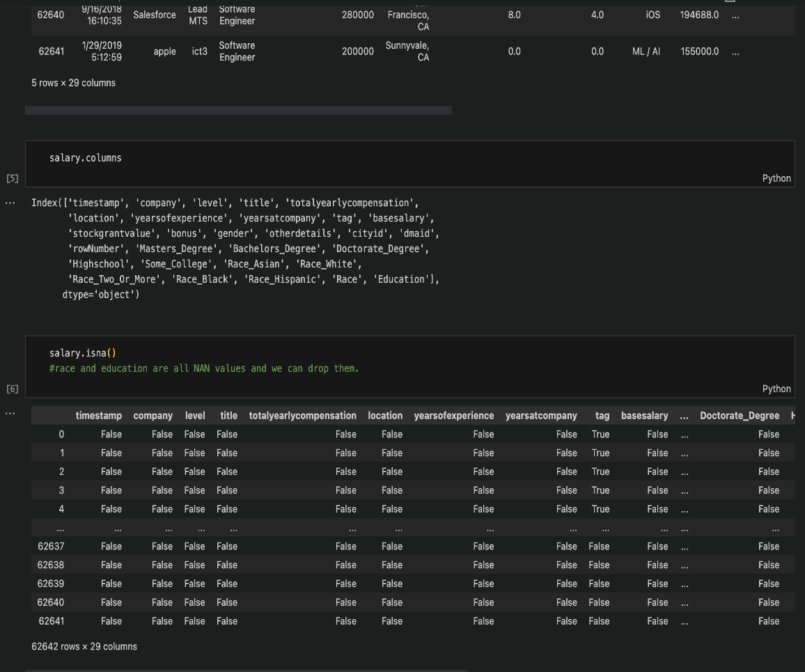
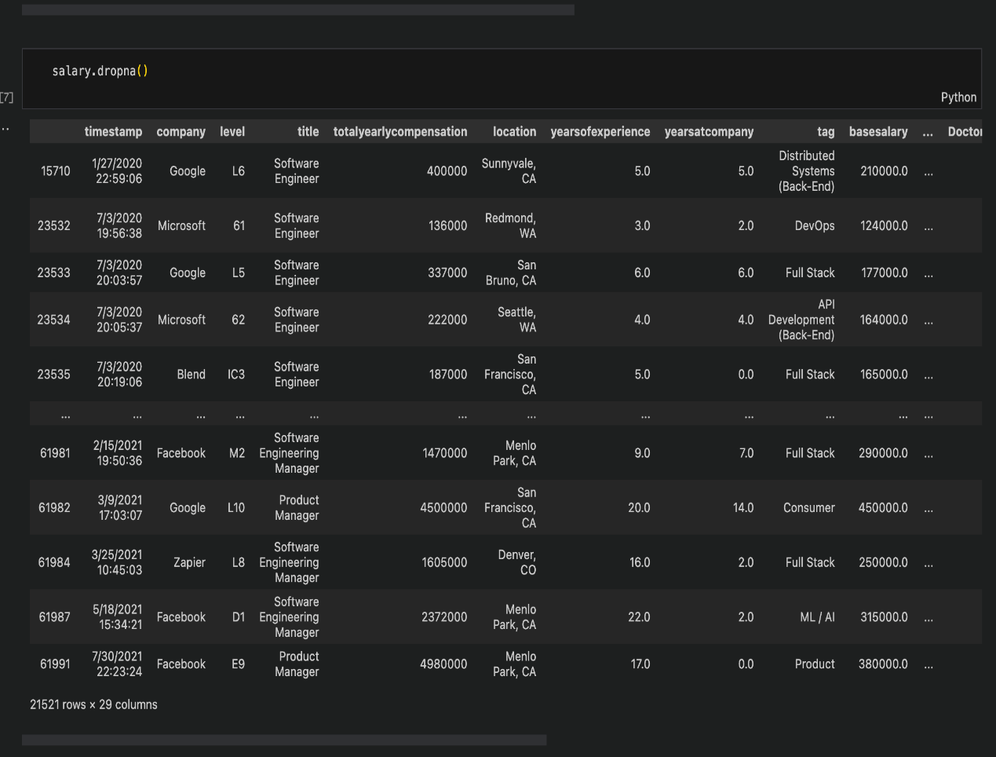
Data Cleaning

Slide 6
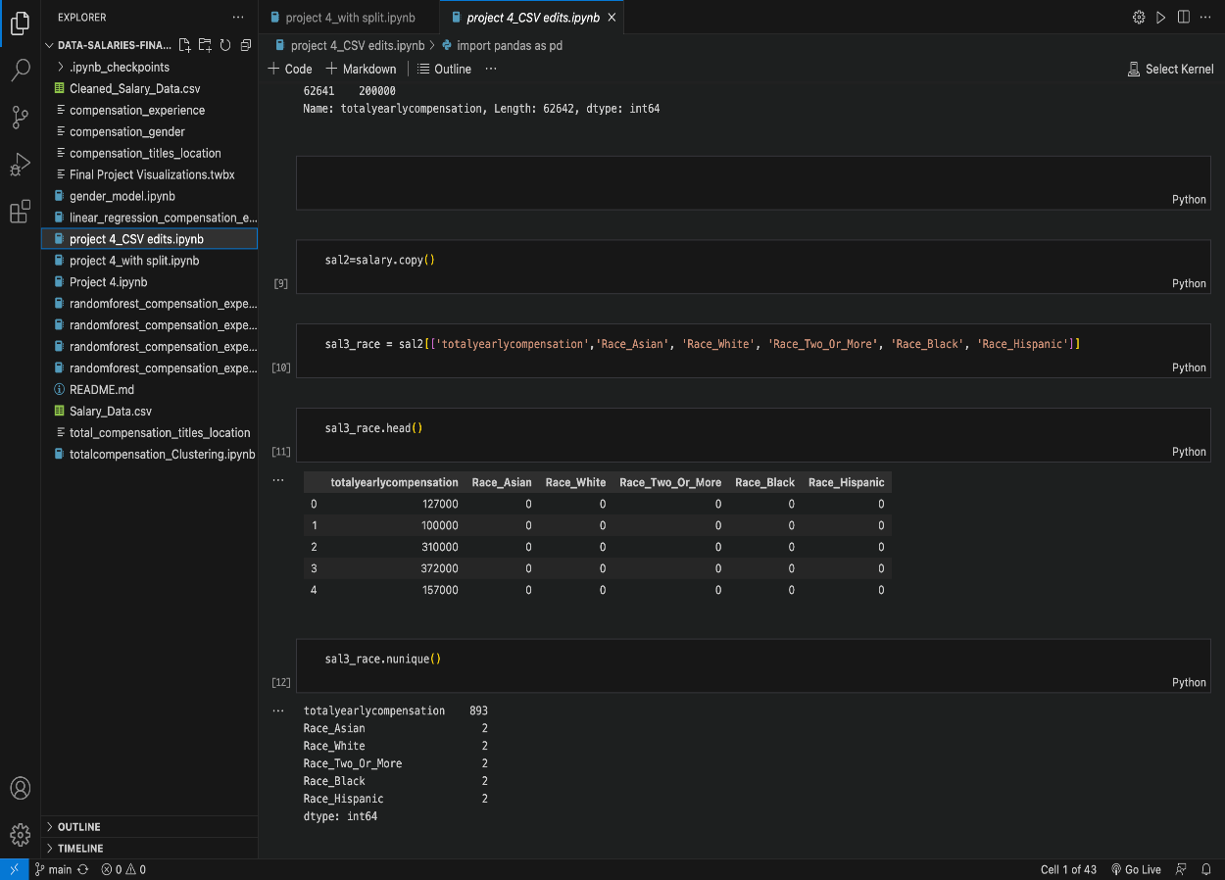
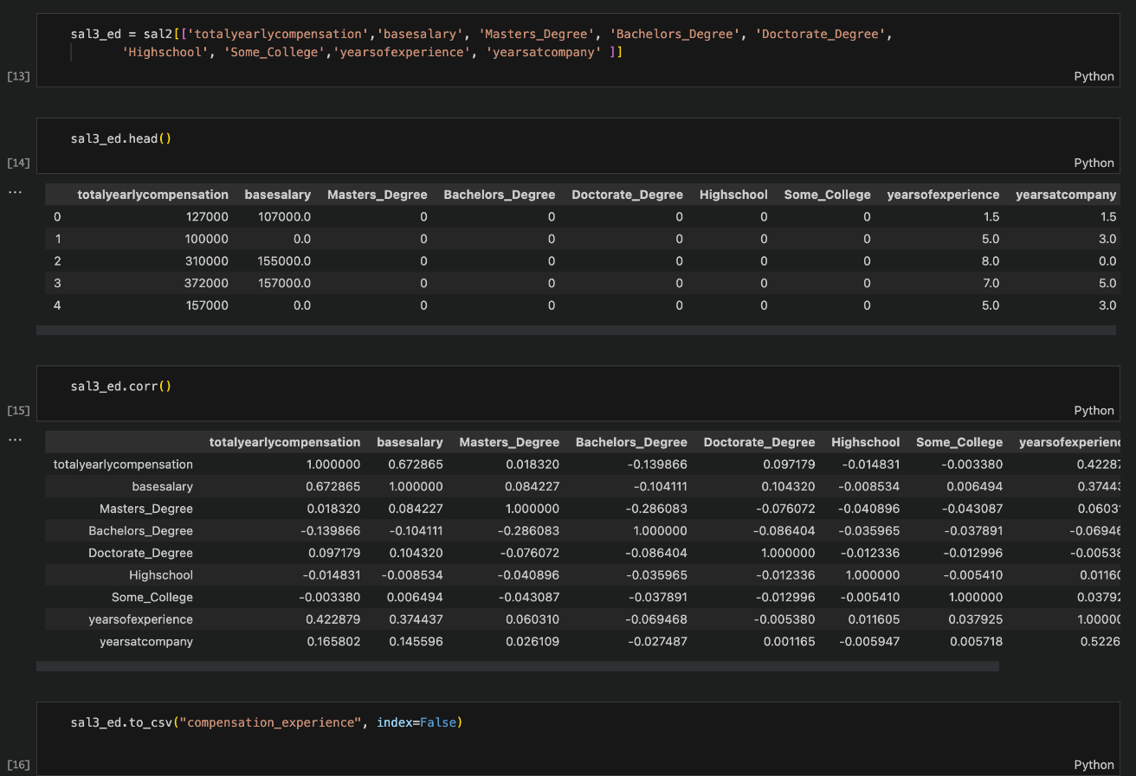
Data Cleaning

Slide 7
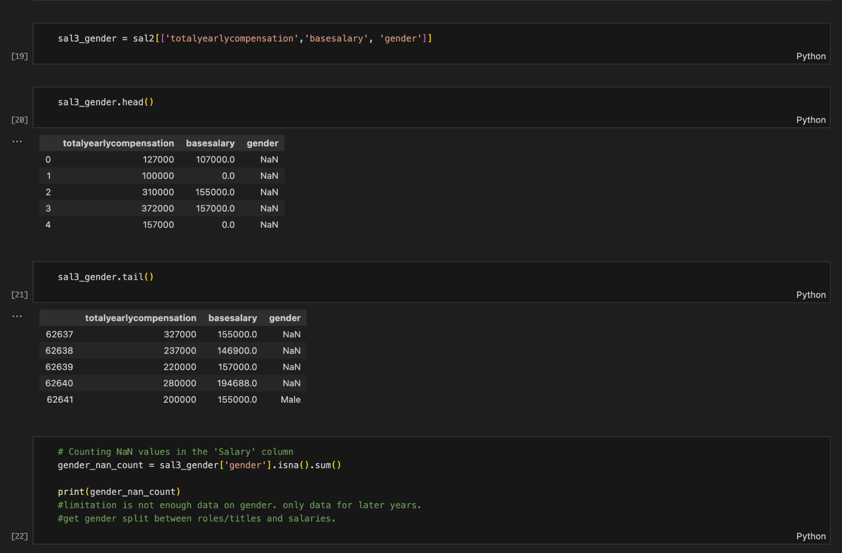
Data Cleaning

Slide 8
VISUALIZATIONS

Slide 9
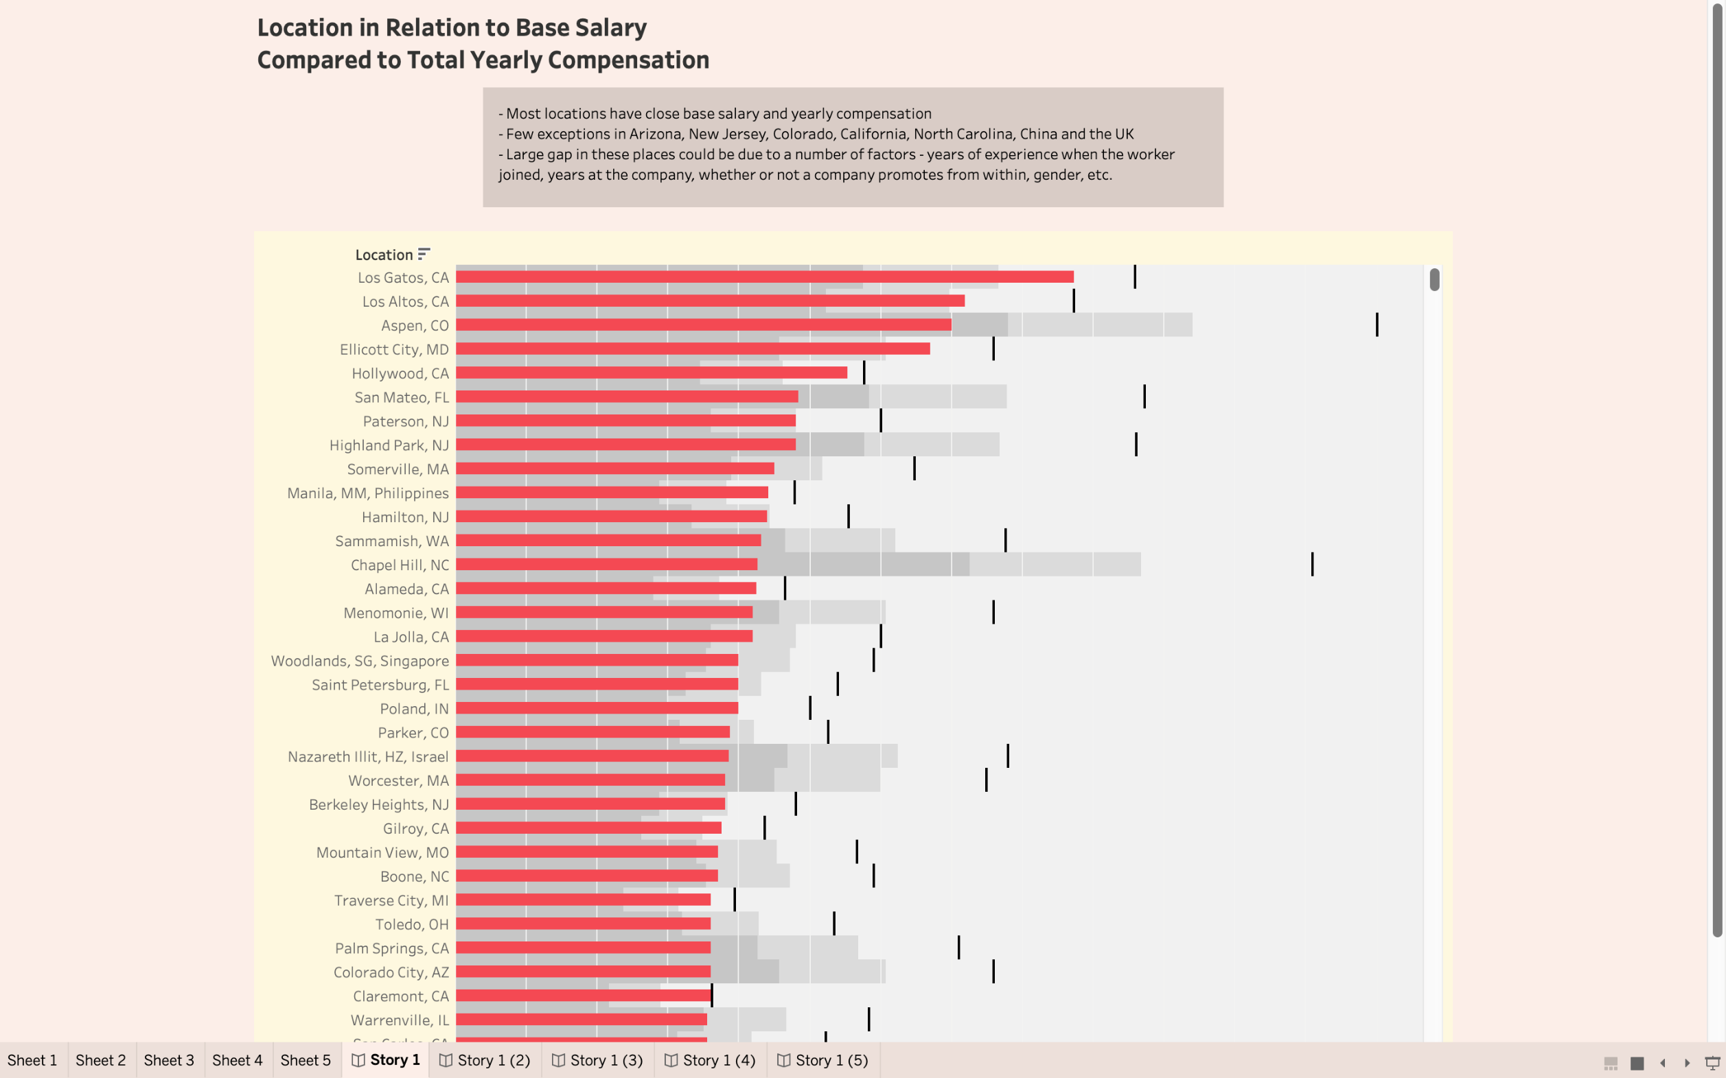

Slide 10
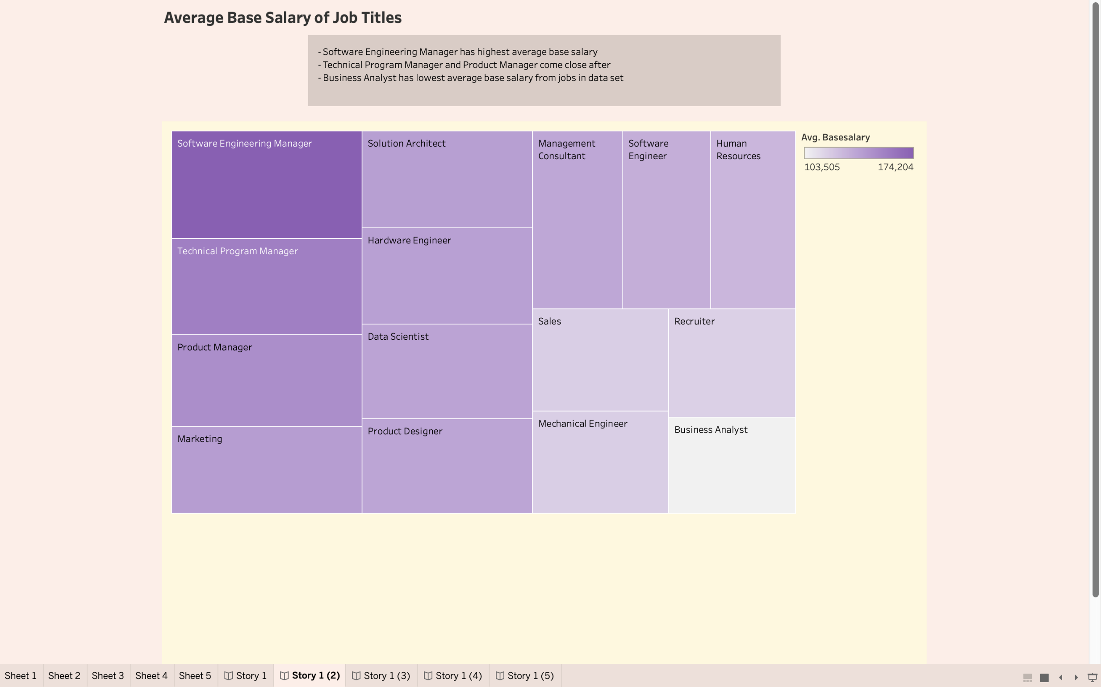

Slide 11
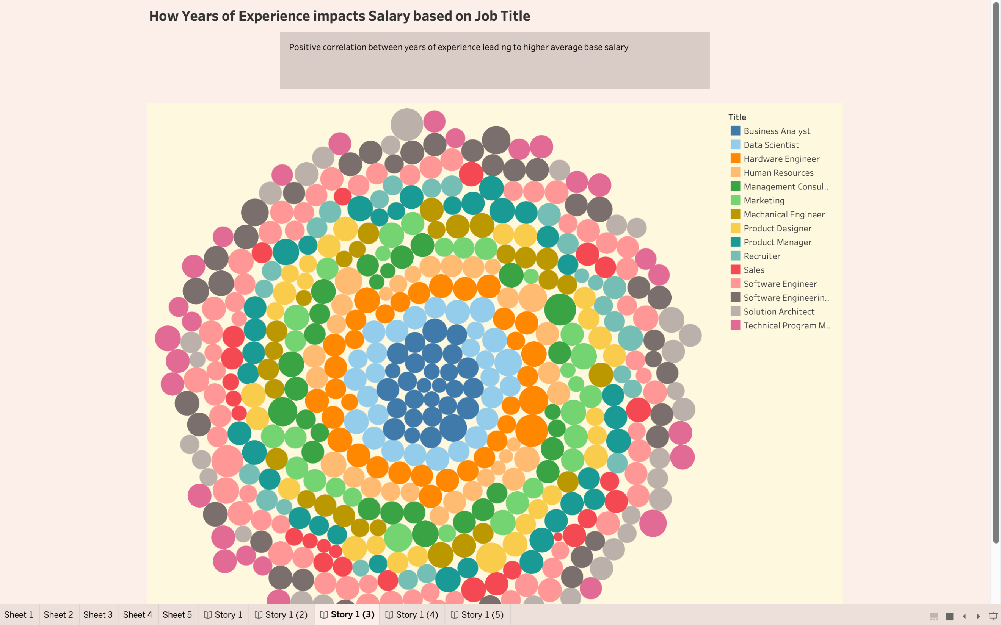

Slide 12
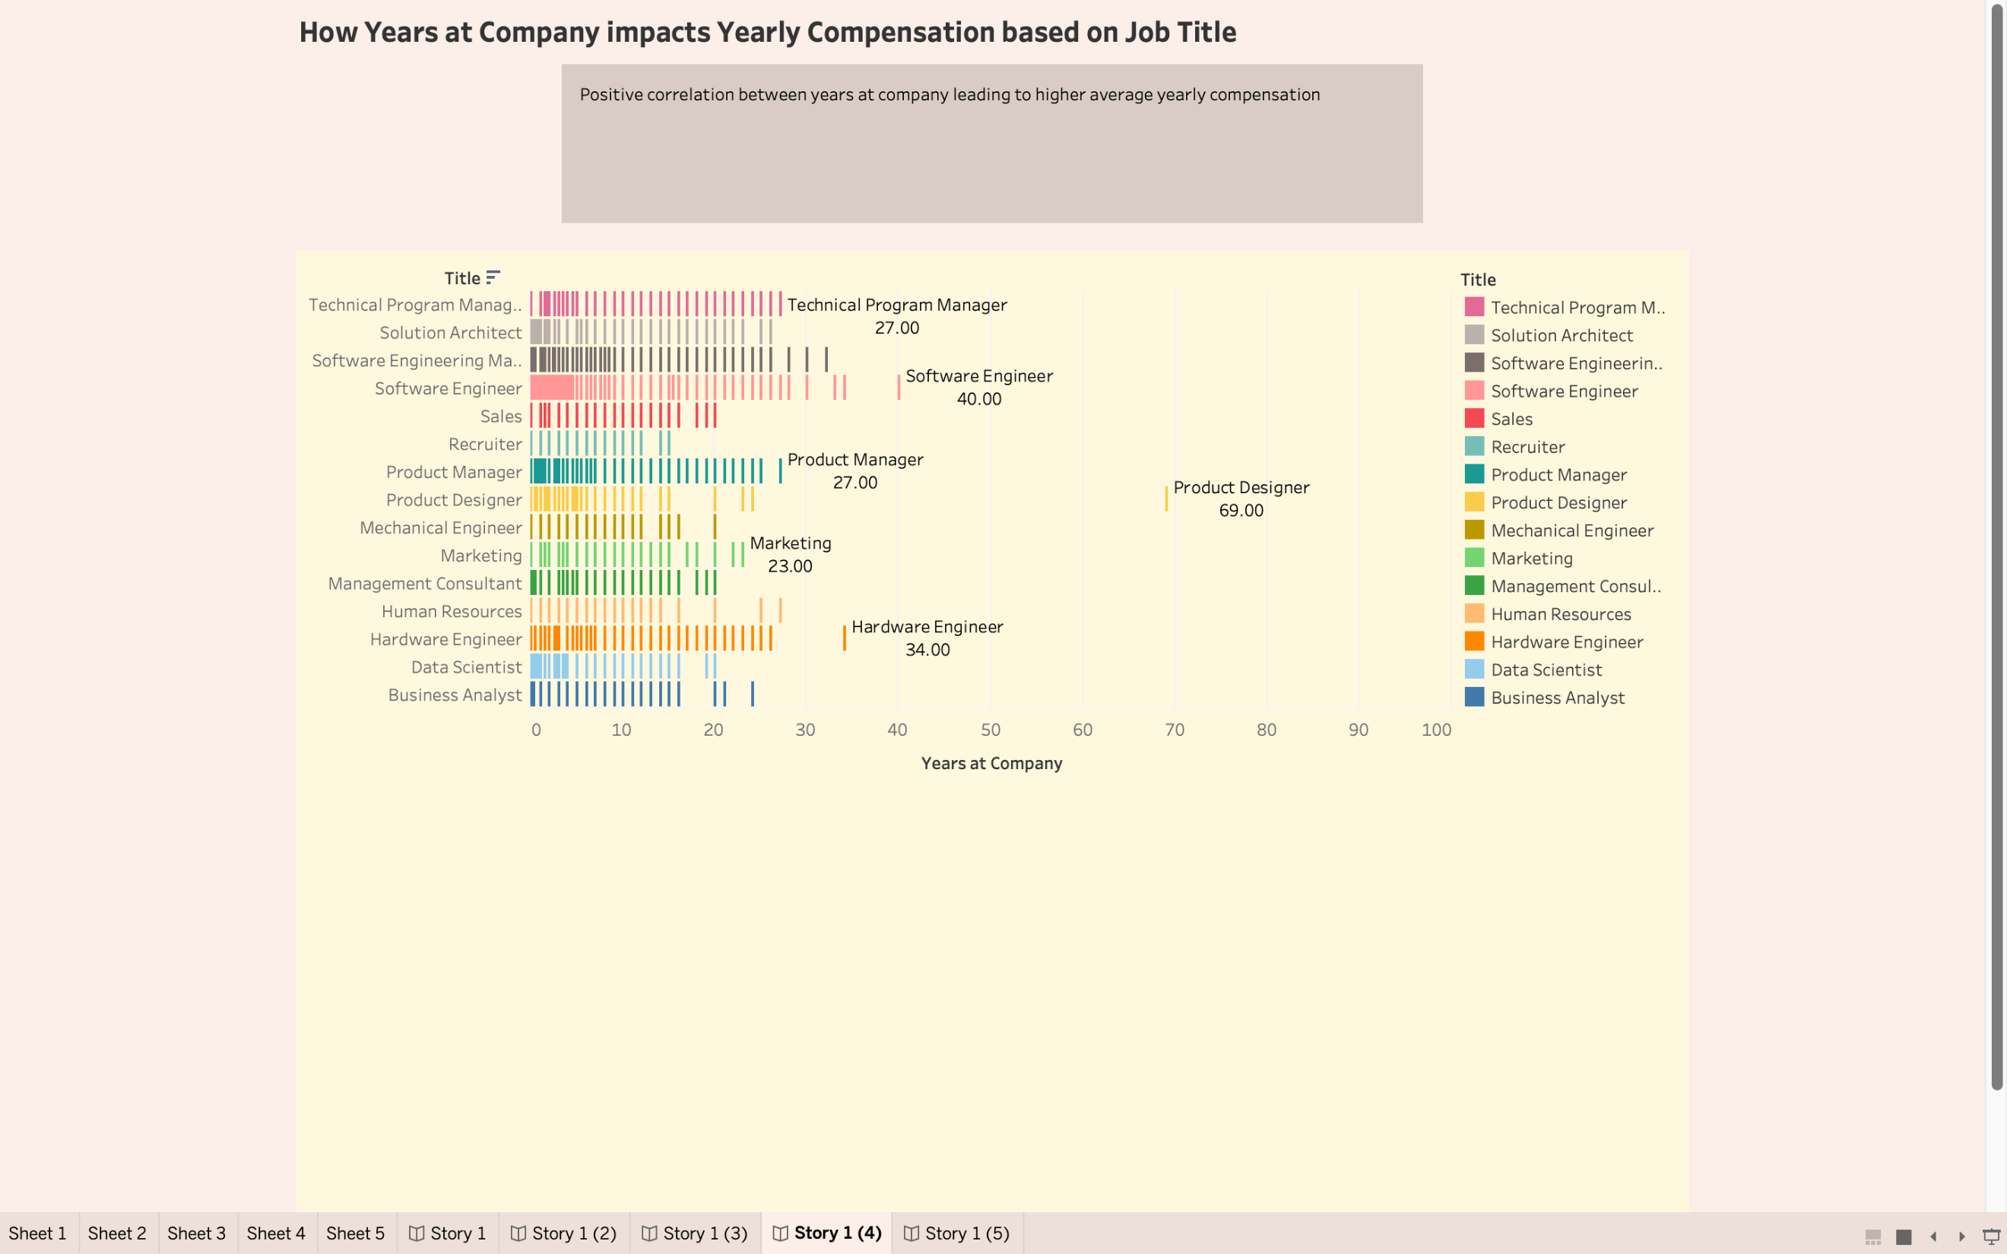

Slide 13
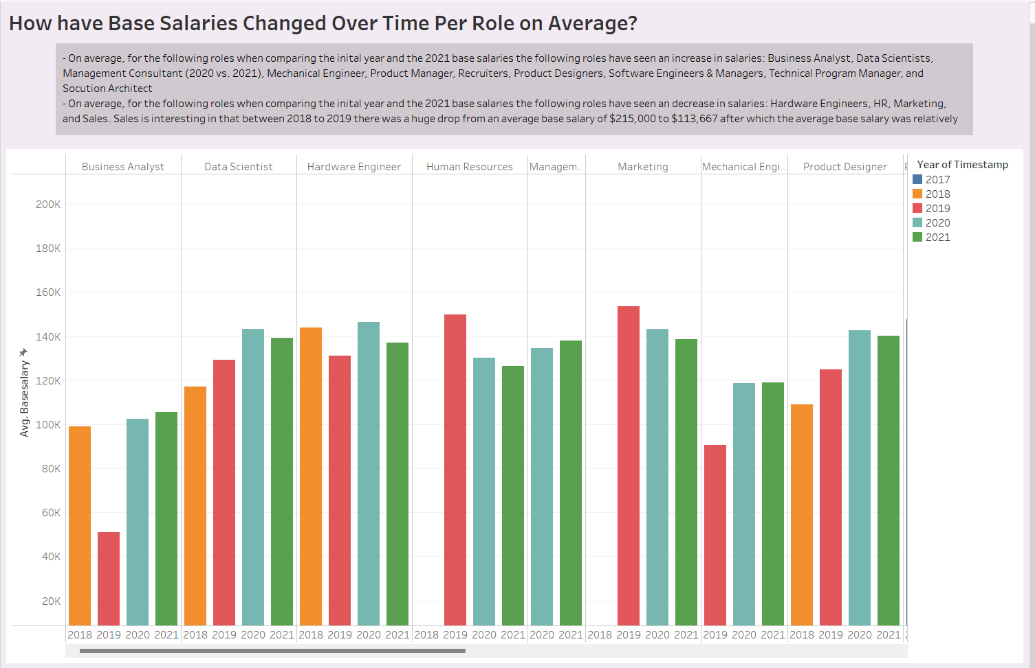
Visualizations

Slide 14
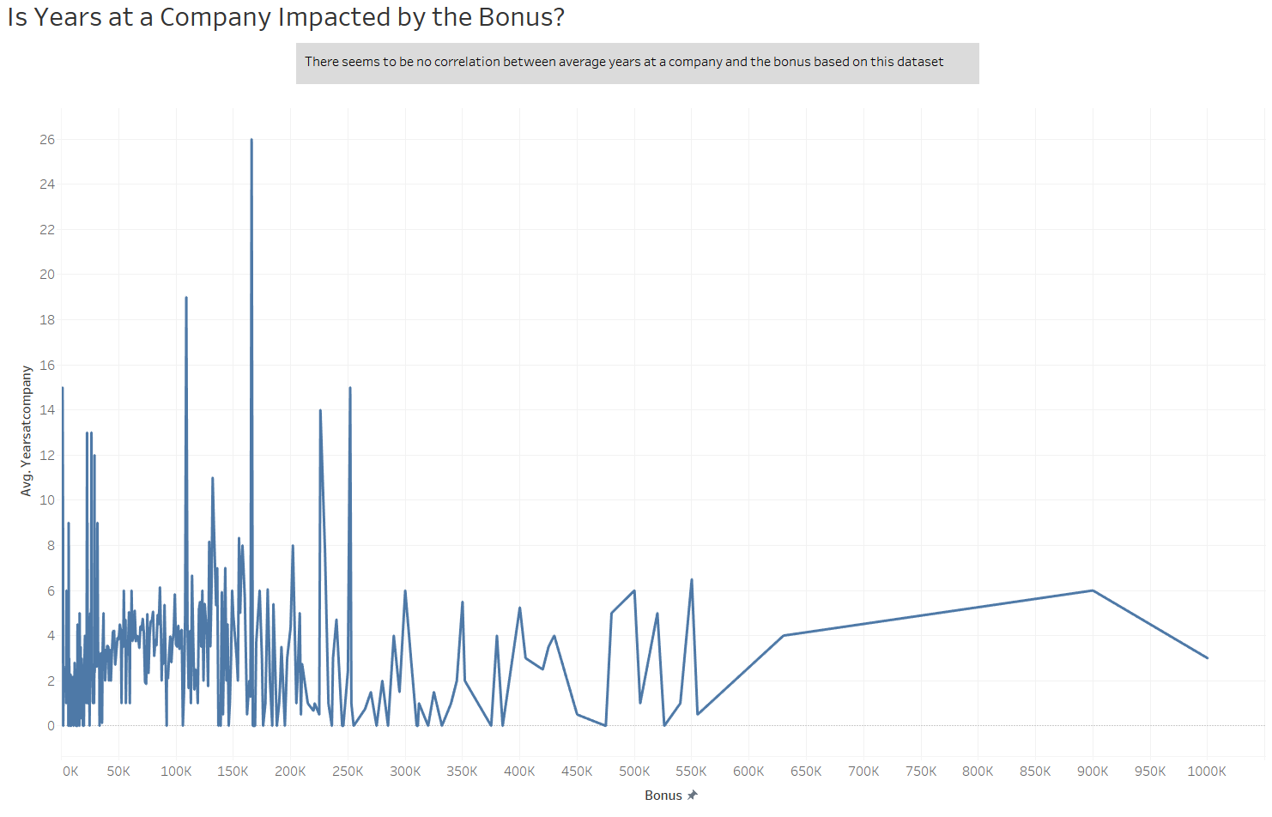
Visualizations

Slide 15
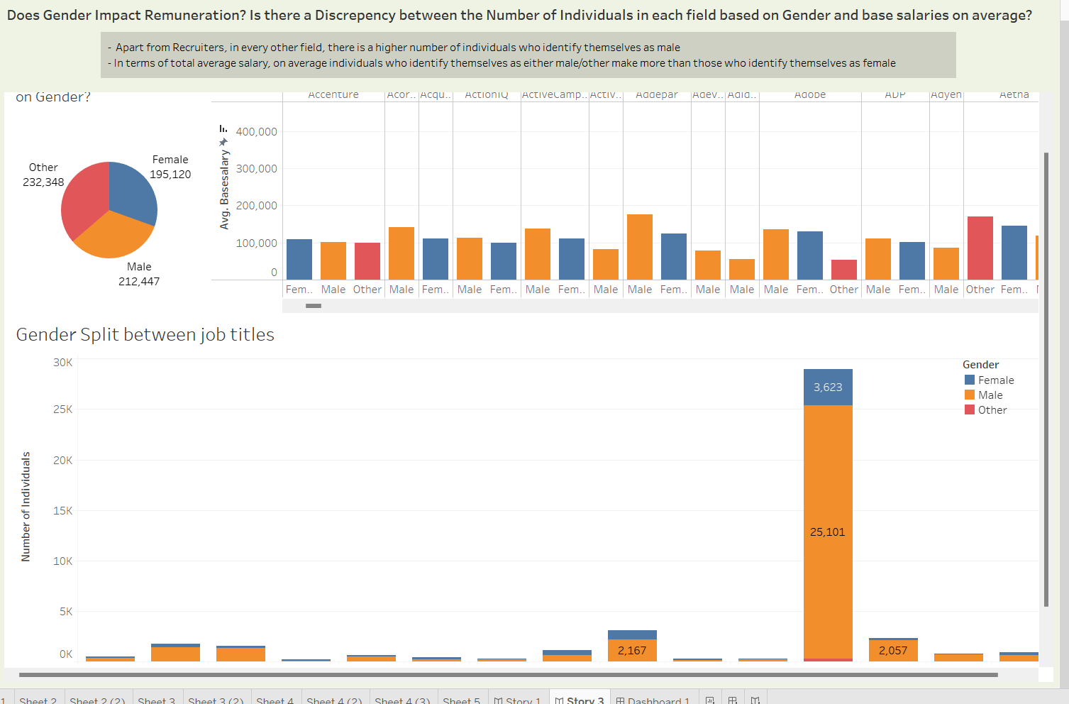
Visualizations

Slide 16
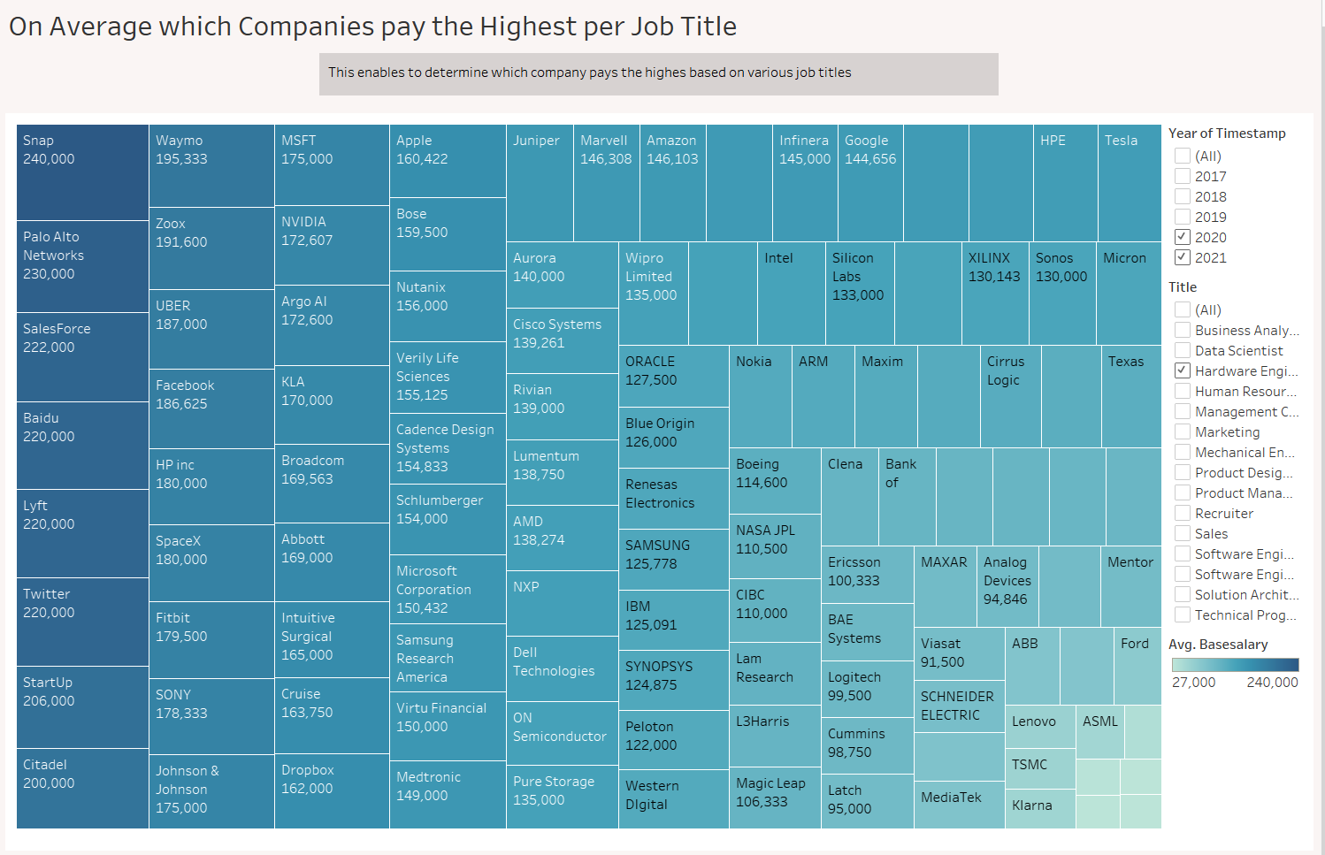
Visualizations

Slide 17
Visualizations

Slide 18
Machine Learning Model

Slide 19
Conclusion

Slide 20
THANK YOU!

